Slide 1
Quality Refresher

Slide 2
General Information
Altice one features.
Regular Prices.
Self-Help Options.
Gift Card Promotion.

Slide 3
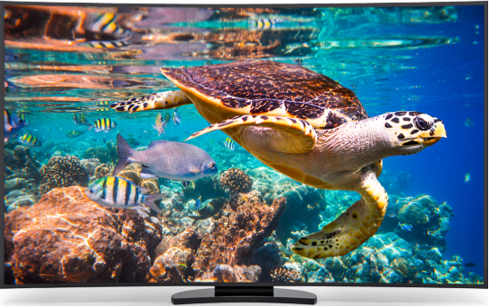
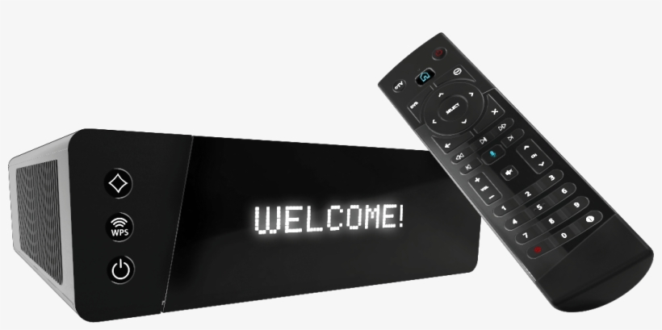
Altice One Features
The Altice One is the first ever gateway 2-in-1 router with a built-in TV box for your Optimum TV and internet services. Each Altice One box will incur a rental fee of $20/Mo along with any charges for service, and the Altice One mini boxes $10/Mo.
Customers will be able to watch select movies, shows and sports in 4k the resolution of HD.

Slide 4
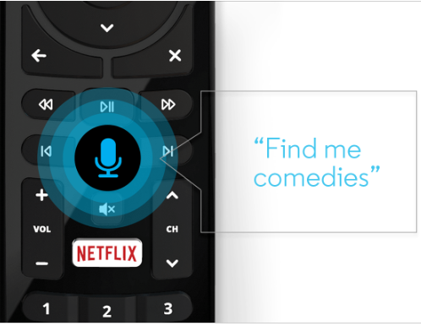
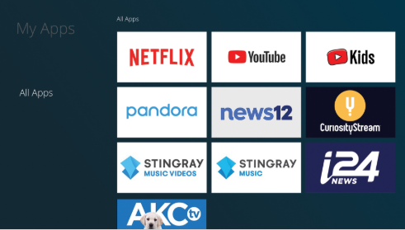
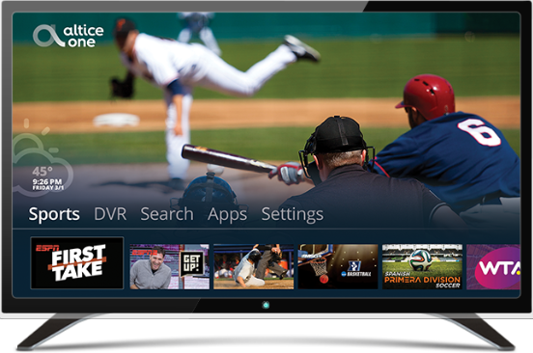
Voice Activated Remote: Bluetooth-enabled remote allows the customers to use voice commands to tune to their favorite channels and TV shows.
Built-In Apps: Customer will have access to all their favorite apps within the Altice One, such as: Netflix, YouTube, Pandora and more.
Personalized Sports: Personalize their sports menu with their favorite teams and leagues and quickly find what games are on now, later, and tomorrow.

Slide 5
Regular Prices
New customers has an opportunity to sample what Optimum has to offer, at a discounted price due to many promotions available at the moment of getting the service. When promotions totally expires, they reach the regular prices.
When a customer already has the service and is requesting to remove one of the three services, they could lose their Triple-Play promotion and go straight to the regular prices. Ex. If a customer is asking, ‘’How much would it be the bill without phone service?’’ You can provide the regular prices for the current services they have without the phone and the promotional discounts as they will be losing it once the phone is removed.

Slide 6
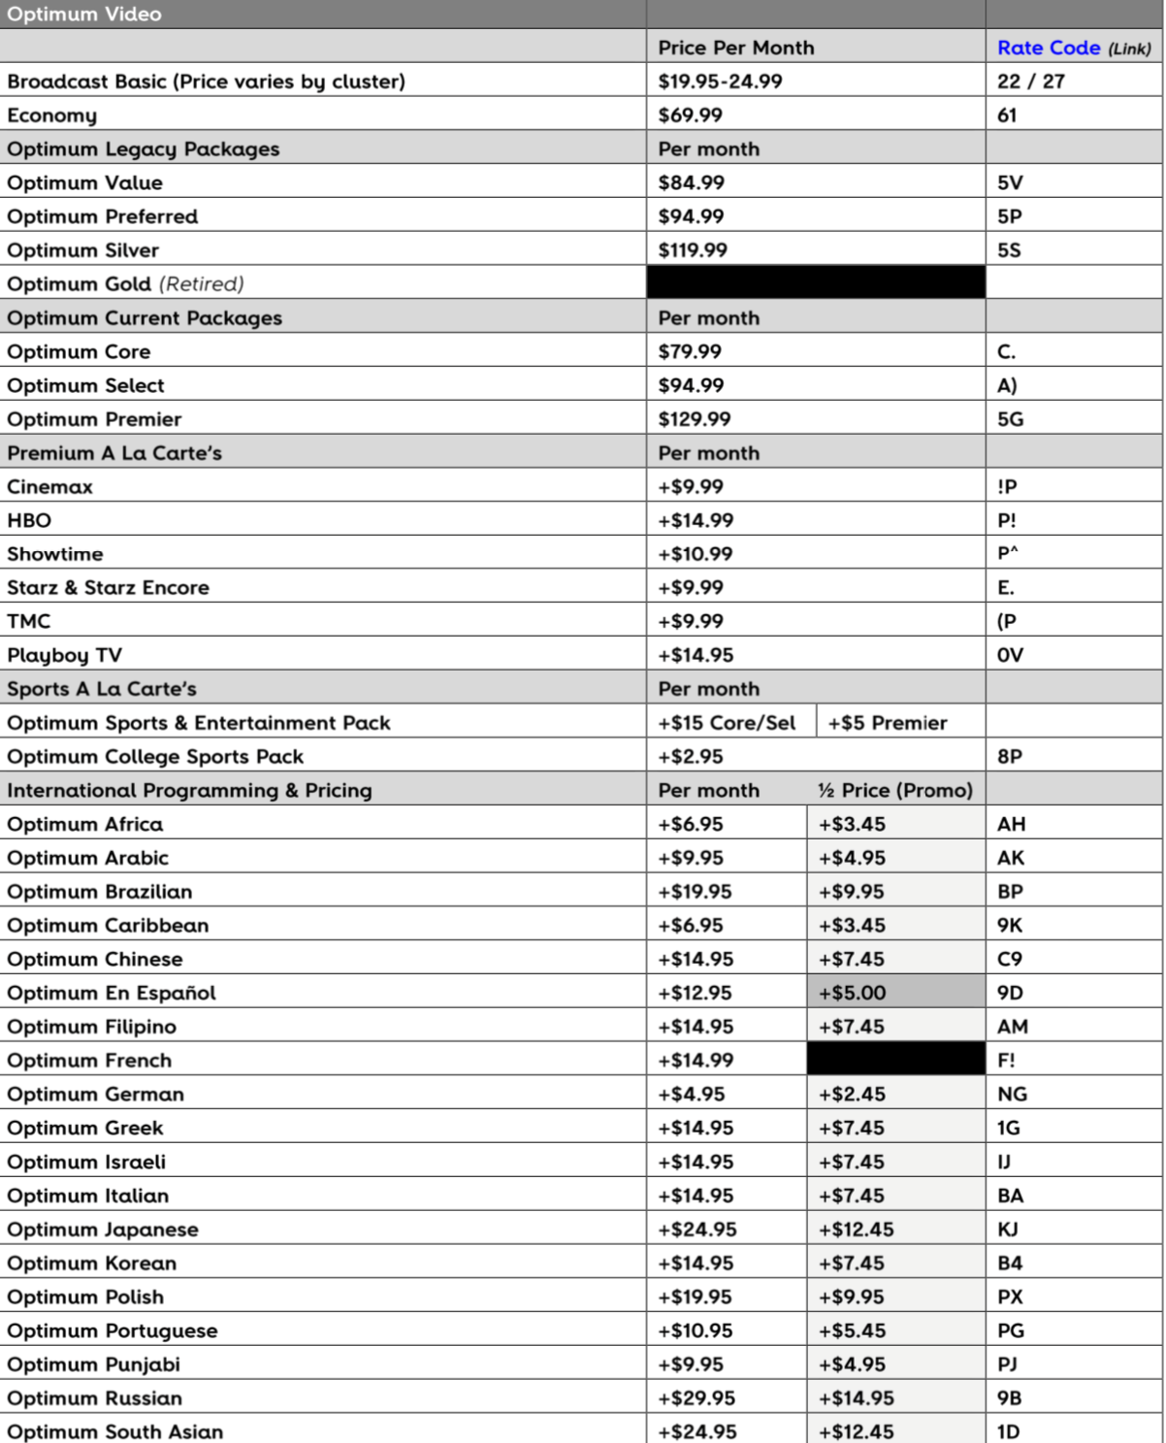
Cable Service Prices

Slide 7
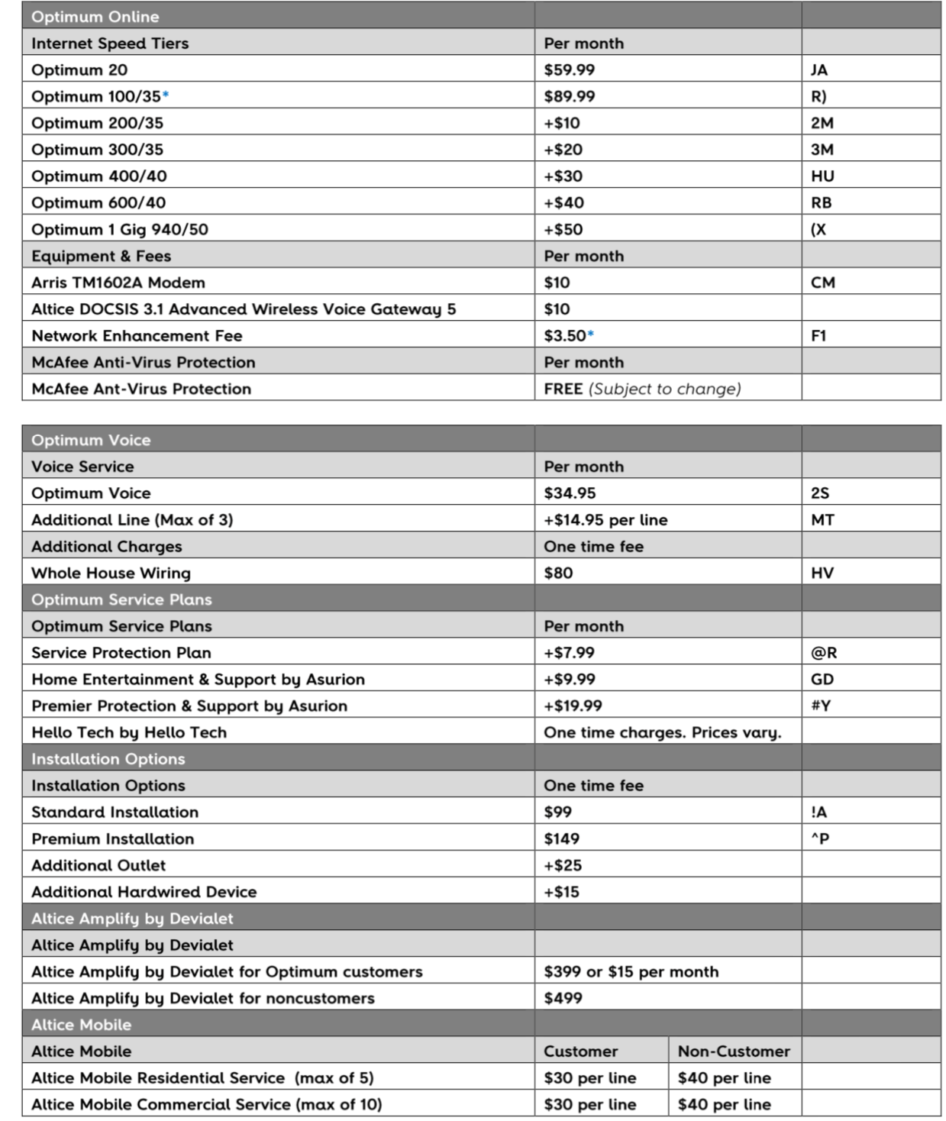
Internet Service Prices

Slide 8
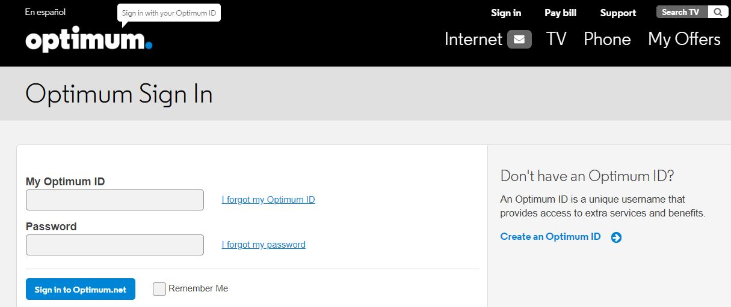
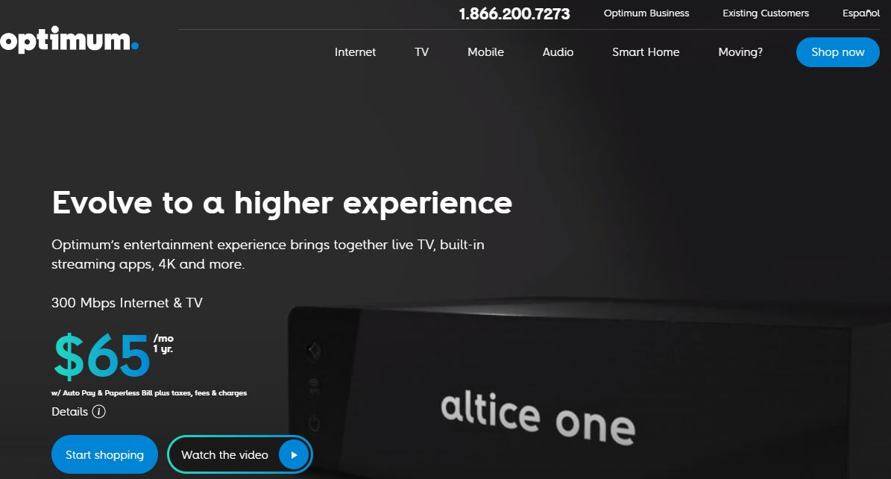
Self-Help Options
Educating the customer about the self-help options that we have such as: Optimum Apps, Automatic Systems, Web Portals and more, is a way to avoid the chance of chatting back for the same concern or issue. Also, it helps the customers to avoid a long time in Queue for a simple information or basic troubleshooting, this make them enjoy a better experience with the service.

Slide 9
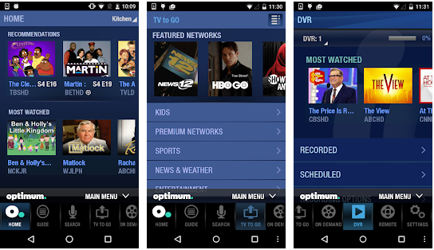
Optimum App Features
TV To Go to watch their favorite Shows on the road.
Free On Demand Library for all networks included on their package.
Watch Live TV within their home.
Manage DVR recordings.
Remote Control.

Slide 10
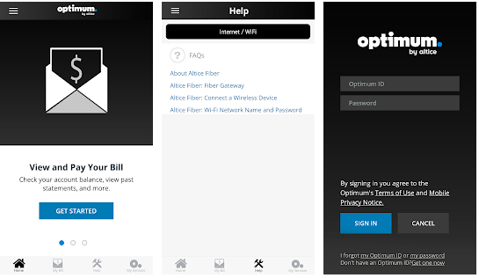
Optimum Support App Features
View and Pay Your Bill on the go.
Basic Troubleshooting steps.
Track Technician route.
Find Optimum Stores locations.

Slide 11
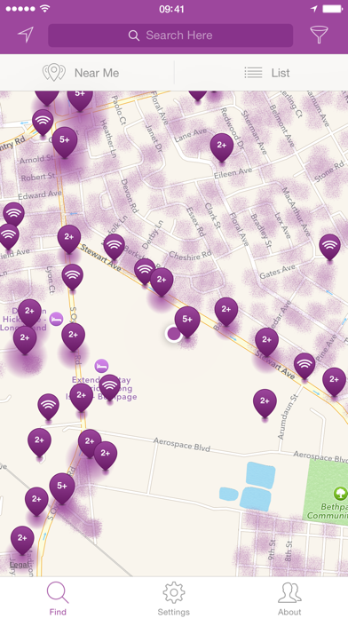
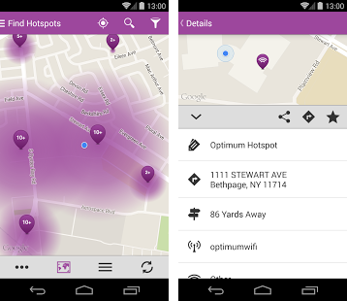
Optimum Wi-Fi Finder Feature
Find Optimum Host-Post wherever you are within the areas that Optimum covers.

Slide 12
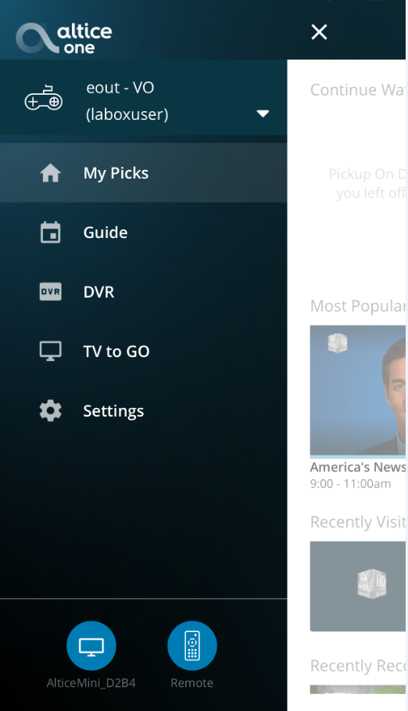
Altice One App
Watch your DVR recordings anywhere you have an internet connection.
Search the channel guide and browse TV listings by day or time.
Use Restart to watch a program from the beginning.
Schedule recordings and manage your DVR.
Use your smartphone or tablet as a remote.
Search for what you want to watch with your voice by content, genre, actor, channel or even a famous quote.
Send your favorite entertainment and apps from your mobile device right to your TV screen.
See who's calling your home phone with caller ID.

Slide 13
Web Portal Features
We have Optimum.com for new customers, where they can find the current promotions and shop the service online.
Optimum.net must be used by current customers to find general information about the service and regular prices, view and pay their bills, setup automatic payments, find the channel lineup, go paperless, find international calls history, manage router, optimum’s IDs and more. In order to access the web-page they must enter the Optimum ID and Password.

Slide 14
Optimum Gift Cards
Altice may offer customers a Gift Card as part of an upgrade, new acquisition or retention Residential (consumer) or Business (SMB) offer.
To be eligible for the Amazon Gift Card, the customer must:
Be a Residential customer in good standing.
Maintain promotion for (90) days of continuous service (Downgrading or upgrading to eligible bundles is permitted).
Not have entered collections at any point during the first (90) days.
No returned payments (Check, credit card).
Last payment clearing successfully. Please refer to the KDB Article ‘’Gift Card offers and Gift Card Tool’’ for more information.

Slide 15
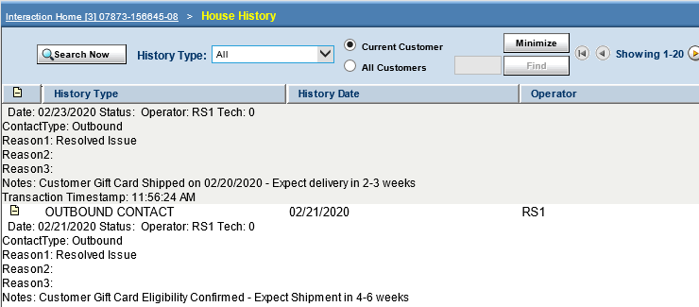
Account Notes (Gift Card related)
If a customer wants to know information about when they will be receiving the Gift Card, please go to the ‘’House History’’ tab to find the notes with this information. See the example below where specify when is going to be delivery.

